Slide 1

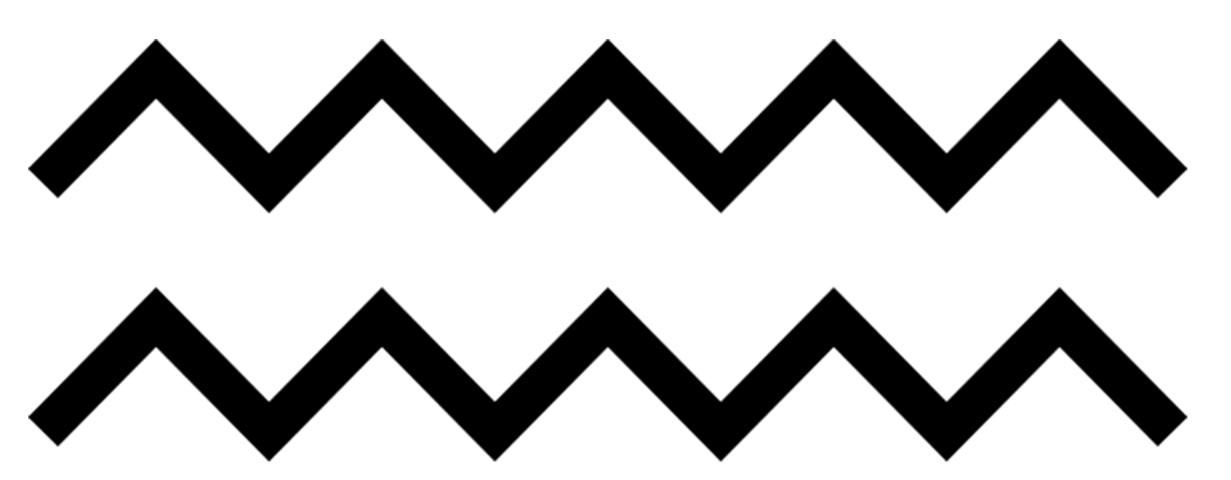
Circuit Boards & PCBs
August 6, 2023

Slide 2
Table of contents
01
02
03
04
05
Introduction
Circuit Board
Wire-Wrap
Stitch Weld
Printed Circuit Boards
Multi Chip Module

Slide 3
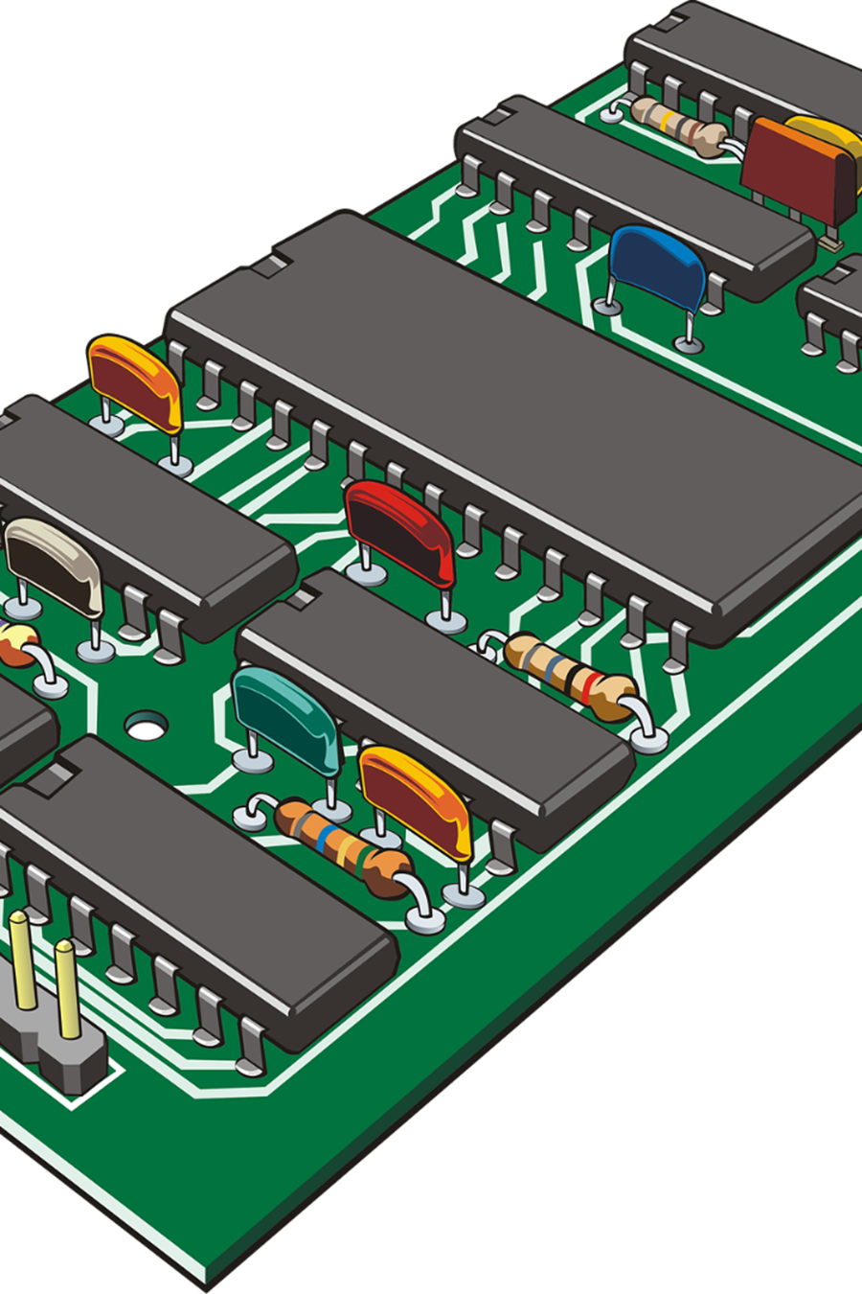
Circuit Board Technologies
There are several technologies available for connecting components and circuits.
Circuit boards combine electronic components and connectors into a functional system through electrical connections and mechanical support.
Some of the widely used technologies are stitch weld, wire wrap, PCB, chip on board, hybrid circuits, and MCM.

Slide 4
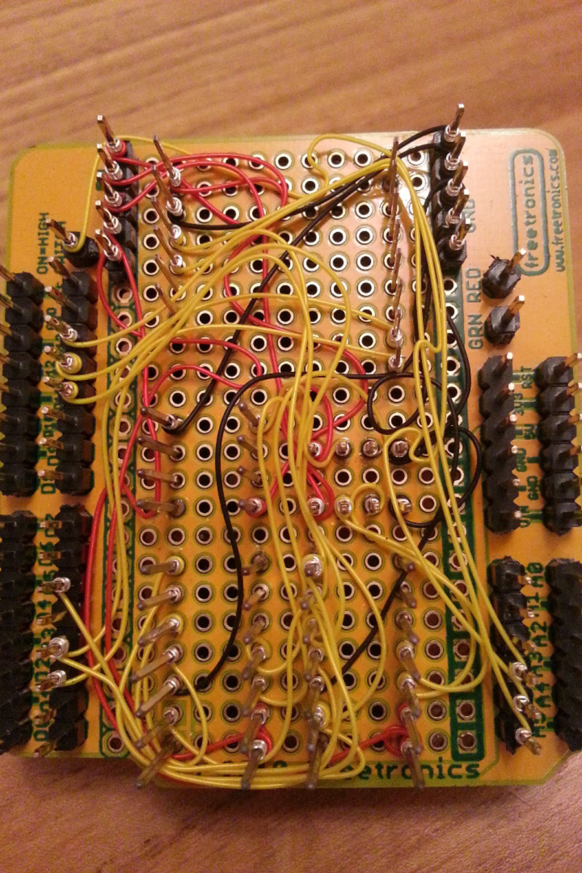
2. Wire-Wrap
The method eliminates the design and fabrication of a printed circuit board.
The wire-wrap technique is useful for prototyping because it allows easy change of connections, circuit modifications, and corrections.
However, larger circuit boards require extensive effort to design.
Wire-wrap is less useful for production, as it is limited in operation to less than 5 or 10 MHz, above which the loop inductances in the wired connections distort signals.

Slide 5
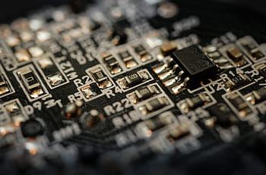
3. Stitch Weld
Stitch weld connects components with point-to-point wiring on circuit boards much like wire wrap.
However, stitch weld ports are shorter, and the wire is welded to the pins instead of being wrapped.
This results in lower loop inductance and much higher operation, up to 100 MHz.
Stitch weld provides better vibration and shock resistance but is more expensive and requires a special welding station.

Slide 6
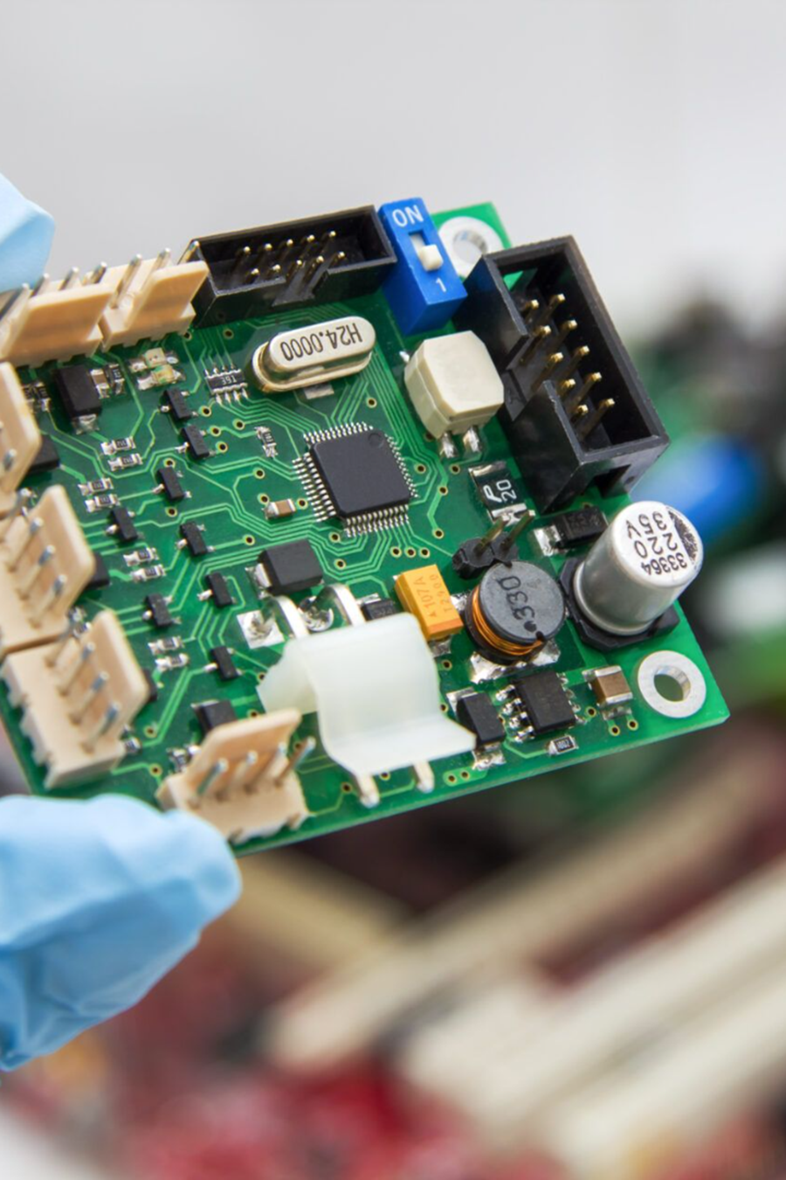
4. Printed Circuit Boards (PCBs)
PCBs use etched and plated connections, making automated placement and soldering of components possible and allowing for better control of impedances than wire wrap.
PCBs are cost-effective, offer reliable and consistent trace widths, and are suitable for mass production needs of modern electronics.
PCBs are available in three types: single-sided, double-sided, and multilayer PCBs.

Slide 7
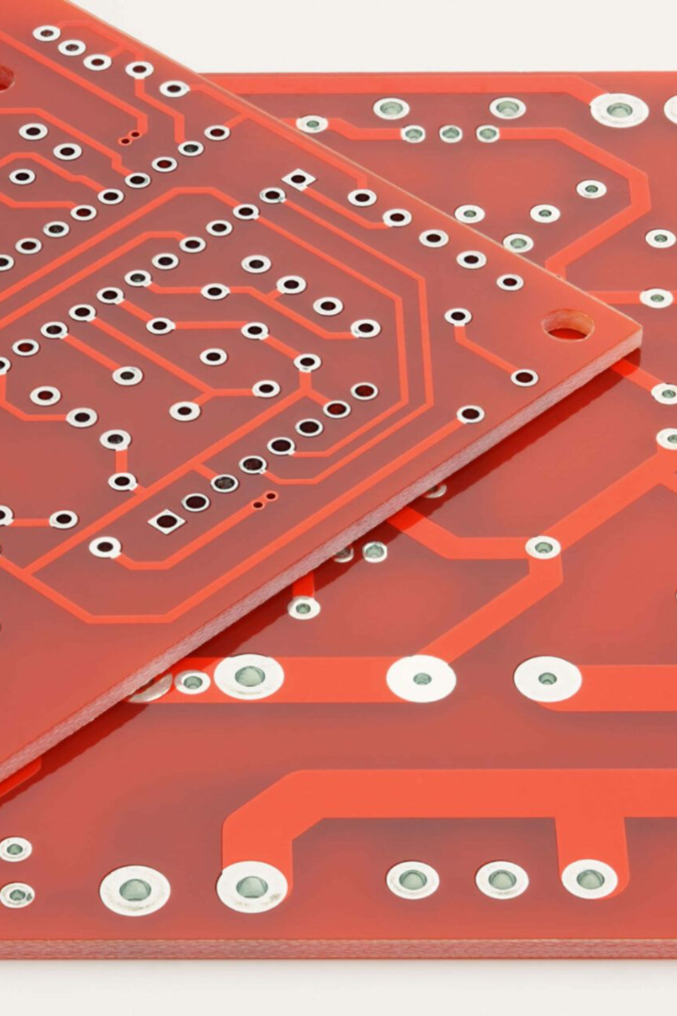
Single Sided PCB
Single-sided PCBs are commonly used for low frequency operations (< 25 KHz) and use signal cross over wire jumpers.
They are simple to design and manufacture and are the least expensive PCBs.
However, they have some limitations and are not suitable for high-frequency operations or more complex circuits.

Slide 8
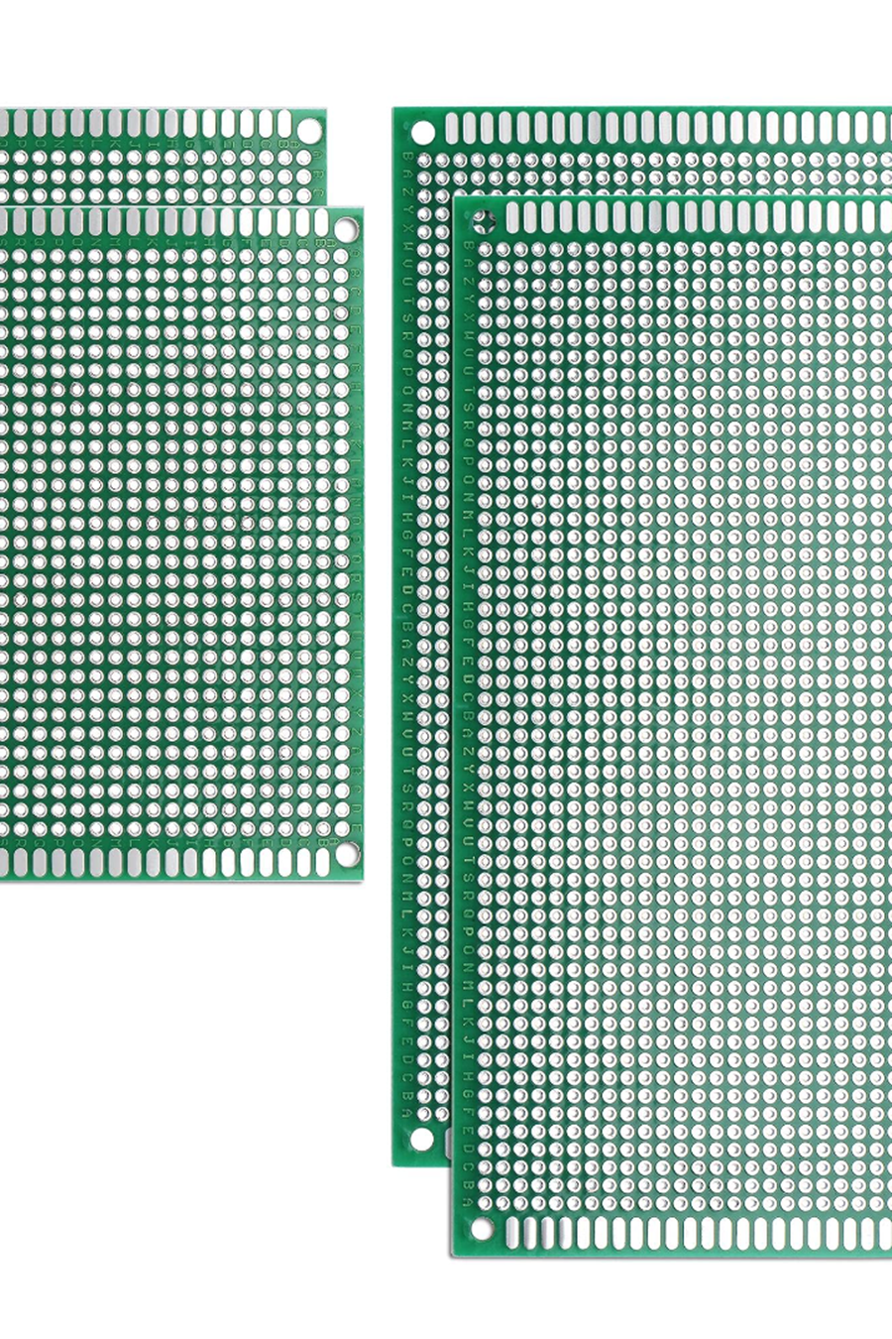
Double Sided PCB
Double-sided PCBs have signal traces on both sides of the circuit board and plated through vias.
They can support higher-frequency operation if laid out carefully and are more suitable for complex circuits.
However, they also have their limitations and require more effort to manufacture than single-sided PCBs.

Slide 9
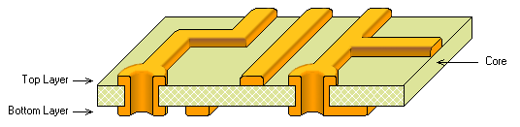
Multi Layer PCB
Multilayer PCBs are a stack of alternate layers of copper-clad laminate or core and prepreg that enables control of impedance much more tightly and is absolutely necessary for high-frequency circuits.
They are available in 20 to 30 conducting layers laminated together.
Multilayer PCBs offer better miniaturization, a higher level of integration, and can accommodate more complex circuitry than single-sided or even double-sided PCBs at the cost of increased manufacturing complexity and higher cost.

Slide 10
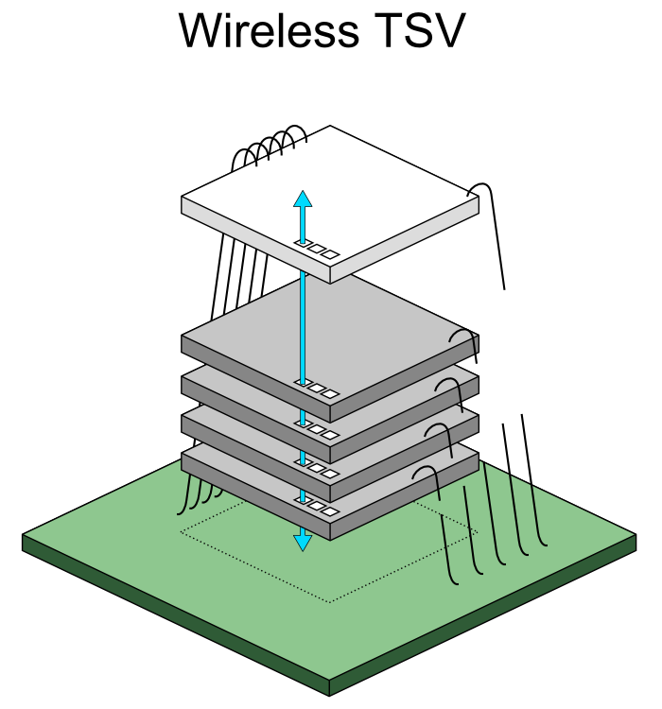
5. Multi-Chip Module (MCM)
Multichip modules offer a higher level of circuit density by bonding the base die of ICs onto a substrate, thereby enabling compact packing, improving signal speeds, and reducing load capacitance.
MCMs are expensive to fabricate but offer high-level integration, which reduces the size of electronic gadgets.

Slide 11
Meet Our Team
Vesuvius
Khatiwada
Titikshyu
Adhikari
077BEL048
077BEL047
Manish
Bhattarai
Thamman
Malla
077BEL023
077BEL046

Slide 12
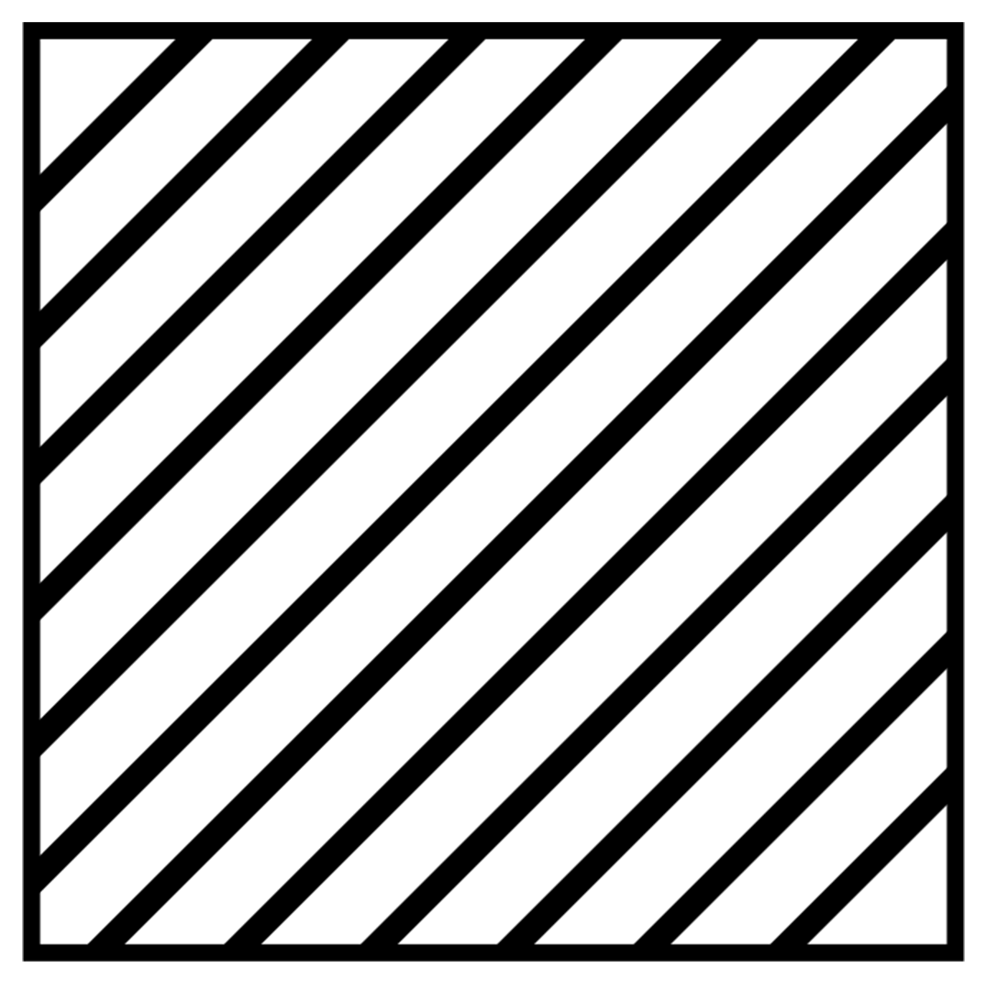
Thanks!
Do you have any questions?

